Slide 1


Taxi Management
May 27, 2021
Database

Slide 2

Taxi Management
May 27, 2021
1
Introduction to MongoDB
2
SQL vs NoSQL
Main part
Main part
3
Database Implimentation
4
Summary

Slide 3
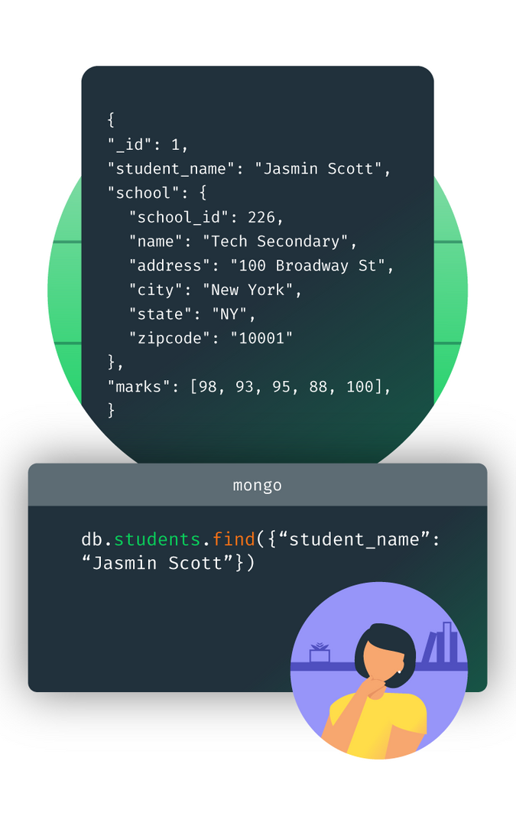
Taxi Management
May 27, 2021
Mongo DB
MongoDB is a document database, which means it stores data in JSON-like documents with dynamic-schema.
The data objects are stored as separate documents inside a collection — instead of storing the data into the columns and rows of a traditional relational database

Slide 4
Pros and Cons
Pros
Document oriented
High performance
High availability — Replication
High scalability – Sharding
Dynamic — No rigid schema.
Flexible – field addition/deletion have less or no impact on the application
Cons
A downside of NoSQL is that most solutions are not as strongly ACID-compliant (Atomic, Consistency, Isolation, Durability) as the more well-established RDBMS systems.
Complex transaction
No function or stored procedure exists where you can bind the logic

Slide 5
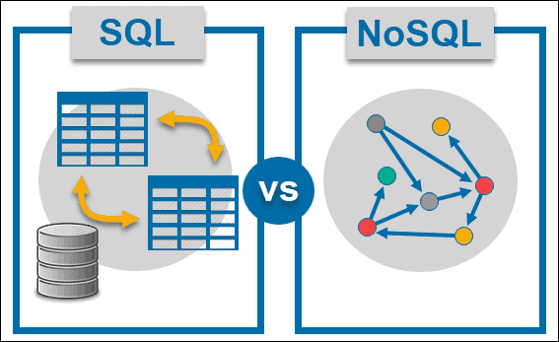
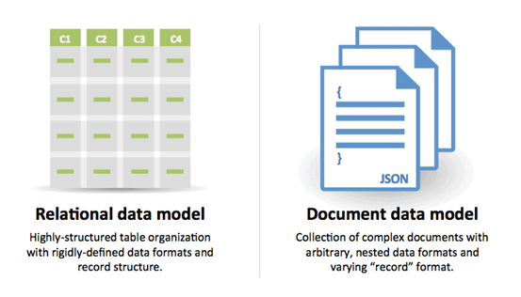
SQL & NoSQL
There are five main critical differences of SQL vs NoSQL
SQL databases are relational, NoSQL are non-relational.
SQL databases use structured query language and have a predefined schema. NoSQL databases have dynamic schemas for unstructured data.
SQL databases are vertically scalable, NoSQL databases are horizontally scalable.
SQL databases are table based, while NoSQL databases are document, key-value, graph or wide-column stores.
SQL databases are better for multi-row transactions, NoSQL are better for unstructured data like documents or JSON.

Slide 6
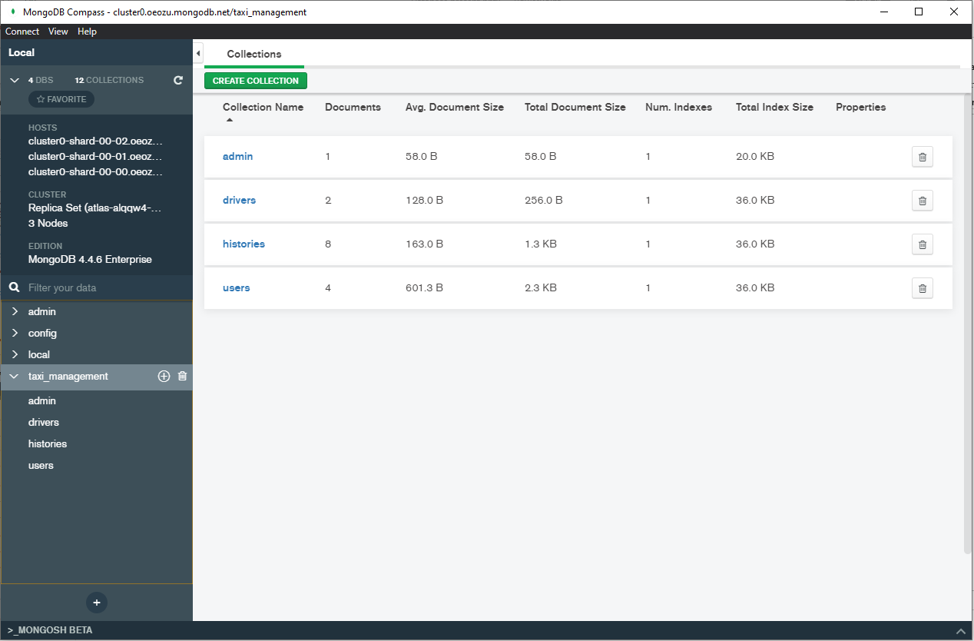

Taxi Management
May 27, 2021
Our Database
Are you ready?

Slide 7

Taxi Management
May 27, 2021
Our Database
1
Admin
2
User
3
Driver
4
Histories

Slide 8

Admin

Slide 9
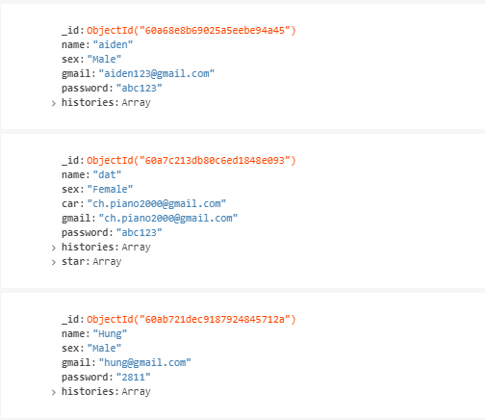
User

Slide 10
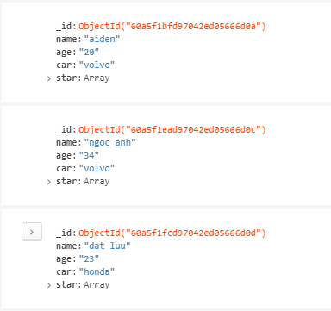
Driver

Slide 11
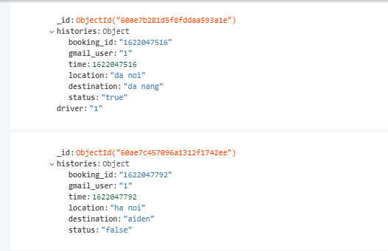
Histories

Slide 12
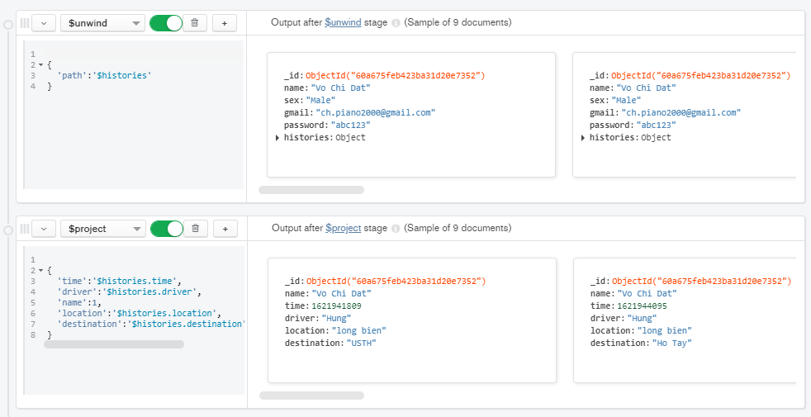
Aggregations
User pipeline

Slide 13
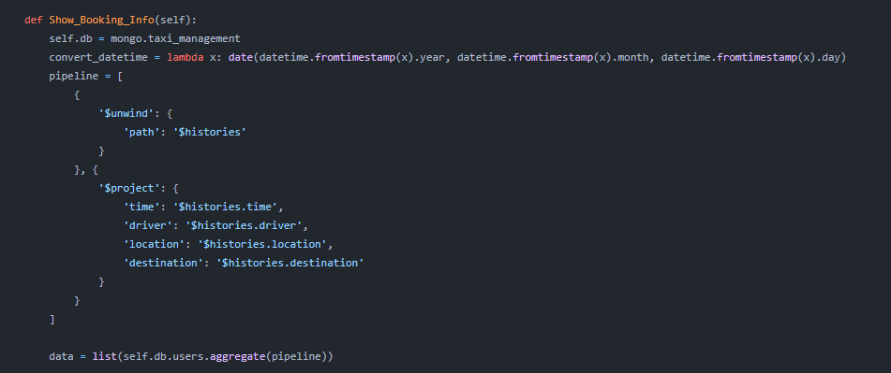
Aggregations
Pipeline implementation in python

Slide 14

Taxi Management
May 27, 2021
We're done!
Thank you for participating. Have a great day ahead.

